Slide 1
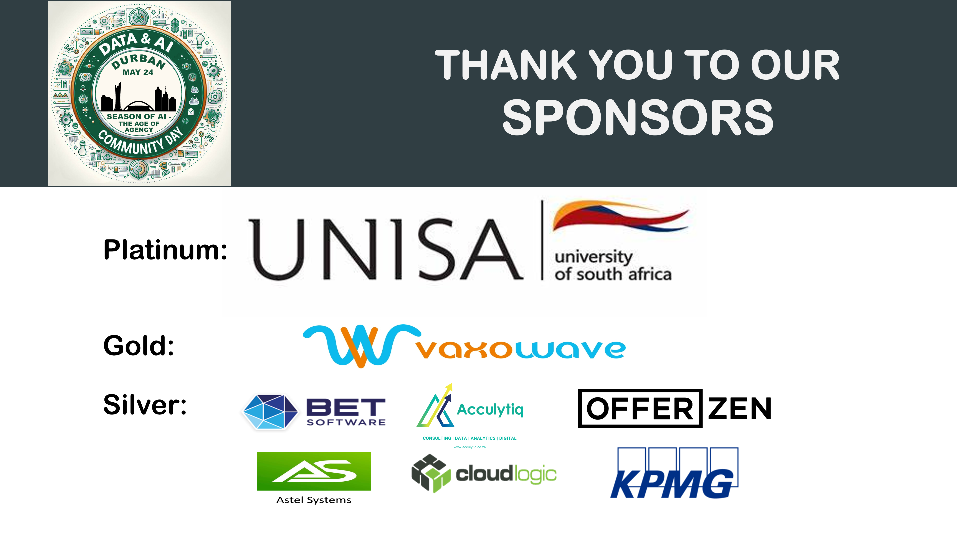
Notes:
Thank you for our Sponsor’s.
Thank you to Niels and the team for the hard behind the scenes.
And thank you to everyone for being here.

Slide 2
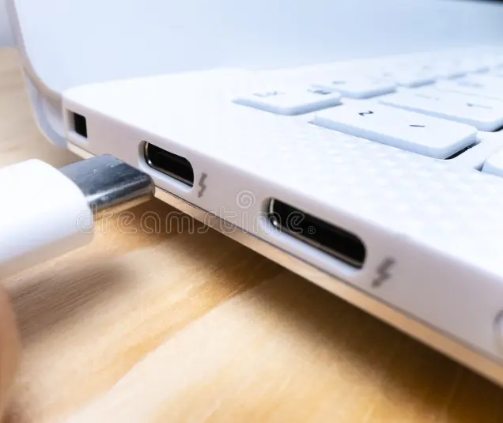
From APIs to MCP: AI Integration in Finance
Notes:
Ground rule: If something stumps me I’ll happily say, “I don’t know—let’s find out together.”

Slide 3
Road Map
Why Integration Hurts?
What is Model Context Protocol (MCP)?
How can you use Model Context Protocol (MCP)?

Slide 4
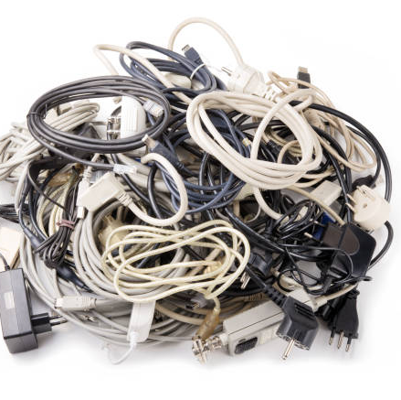
Why Integration Hurts?
Data locked in silos
Weeks-long onboarding
Patchwork fraud defenses
Notes:
Ask: “Who has felt this integration pain?”

Slide 5

What is Model Context Protocol (MCP)?
One standard handshake. Any system.
Notes:
Think of the MCP, as a universal USB-C cable for AI.
Just as USB-C lets any phone or laptop plug into any charger or screen.
MCP is an open protocol that lets any model and any legacy core talk in one shared language — like USB-C ended the drawer full of weird chargers.

Slide 6
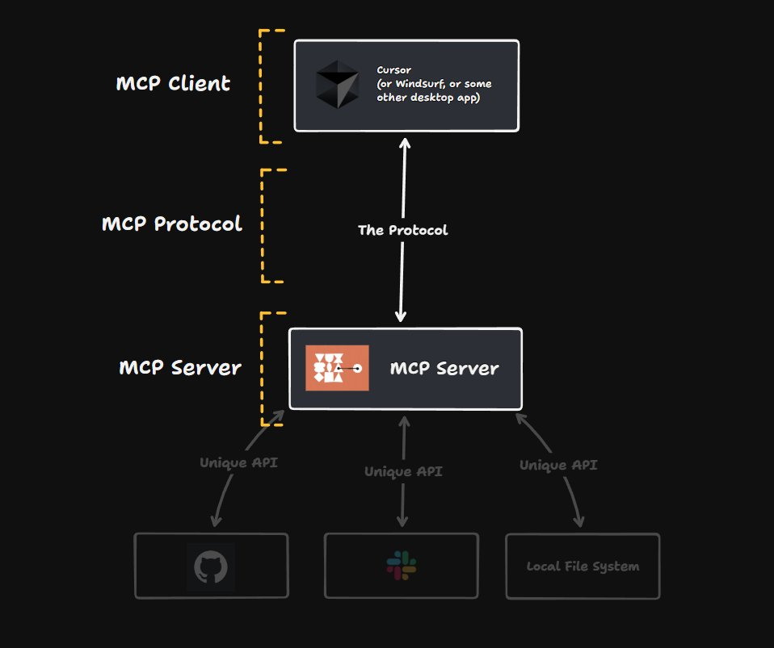
How Model Context Protocol (MCP) Works?
Map intents & data: MCP Client
Transform to model context: MCP Protocol
Deliver results back: MCP Server to MCP Client
Notes:
Map intents & data:
the agent decides what job needs doing and where the right data lives.
Transform to model context
it packs that instruction into MCP’s common ‘plug’—almost like putting the right pins on the USB-C cable.
Deliver results back
data comes straight back through the same port, and the agent translates it into a human answer, or fires off the next action.
Think of the client as the intent mapper, the server as the universal translator, and the arrow between them as the USB-C cable that carries a single, standard signal both ways the protocol

Slide 7

Financial Institutions Wins
Real-time data exchange
Faster KYC (Know Your Customer) & onboarding
Live fraud & CX insights (Customer Experience Insights)
Notes:
Real-time data exchange:
FedNow’s rapid uptake. Less than two years after launch, more than 1 300 U.S. financial institutions are already live on FedNow.
https://www.paymentsdive.com/news/fednow-draws-1300-financial-firms/746106/
Faster KYC (Know Your Customer) & onboarding:
Sardine reads a licence, checks selfie liveness, and returns a decision in < 20 seconds
https://www.chartis-research.com/custom-insights/7947225/keeping-good-company-streamlining-client-onboarding-with-cdi-part-1
Live fraud & CX insights (Customer Experience Insights):
Mastercard’s AI protects 159 B transactions annually and can lift fraud-catch rates by up to 300%
https://www.businessinsider.com/sc/how-ai-at-scale-is-shaping-the-future-of-commerce

Slide 8
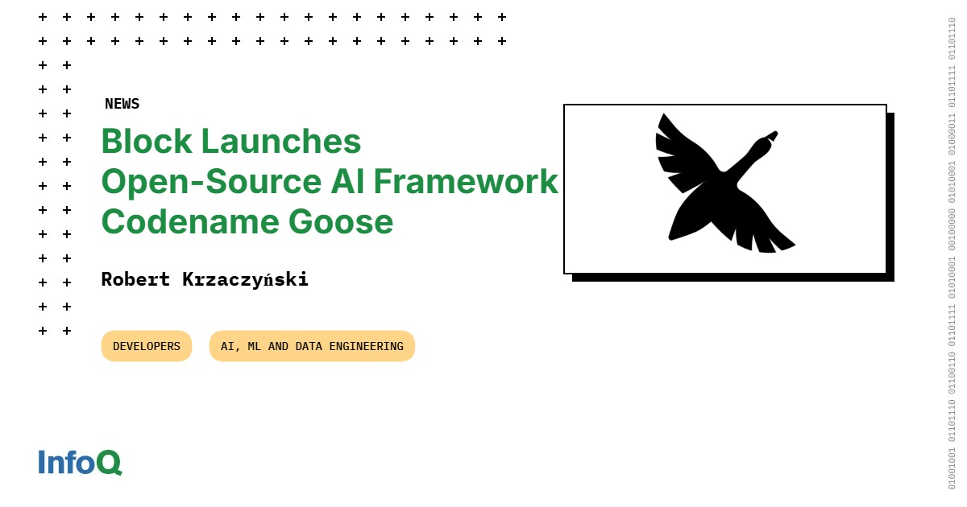
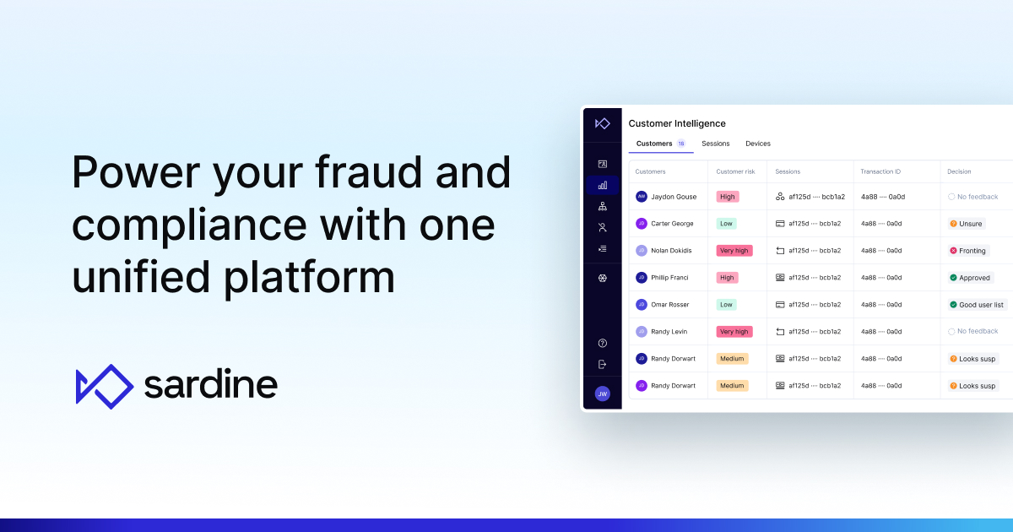
FinTech Innovation in the wild
Block’s goose agents plug into MCP for real-time action.
Sardine’s SDK unifies fraud/KYC via one API
Notes:
https://block.github.io/goose/
https://www.sardine.ai/platform
https://modelcontextprotocol.io/introduction

Slide 9
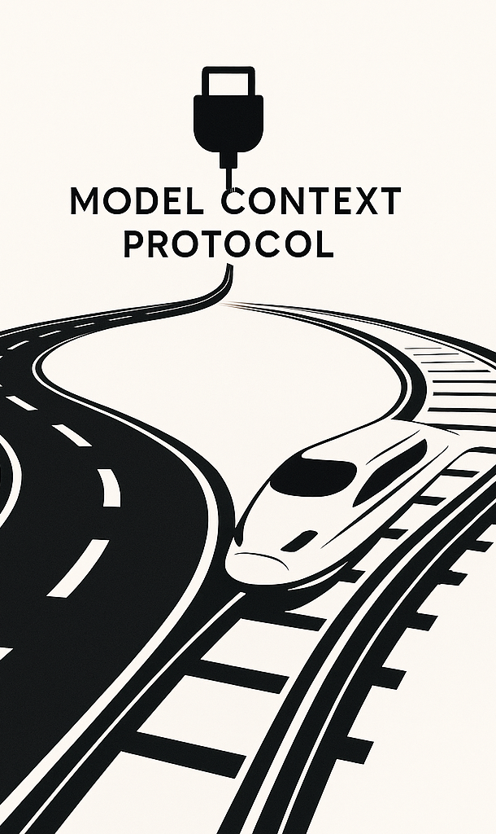
Unlocking new playbooks
Today: Manual mapping, batch jobs, vendor lock-in.
Tomorrow: Plug-and-play models, real-time orchestration, ecosystem agility.
Notes:
Imagine rolling out a new AI feature in one week, not a quarter.

Slide 10
Key Takeaways
MCP = Universal AI Plug
3 moves: Map → Transform → Deliver
Real-time value - today

Slide 11

Questions, Ideas, Challenges?

Slide 12
